Slide 1
ChatGPT Proactive Protection Against Malicious Engagements
Rahul Vattigunta
Master’s project presentation

Slide 2
Introduction
Generative AI: Generative AI refers to deep-learning models that can generate high-quality text, images, and other content based on the data they were trained on.
ChatGPT: ChatGPT is an AI language model developed by OpenAI. It's part of the GPT (Generative Pre-trained Transformer) family. It can engage in conversations, answer questions, provide explanations, and assist with a variety of tasks across different domains
Natural Language Processing: Natural language processing (NLP) is the ability of a computer program to understand written and spoken human language. NLP enables computers to comprehend, generate, and manipulate human language

Slide 3
Motivation
Rising Challenges: Increasing frequency of harmful online interactions is a major concern for digital platforms.
Need for Real-Time Solutions: Quick identification and resolution are essential to maintain a positive user environment and prevent the escalation of negative behavior.
Proactive Approach Benefits: Early detection and intervention can significantly reduce the negative impact on users and communities.

Slide 4
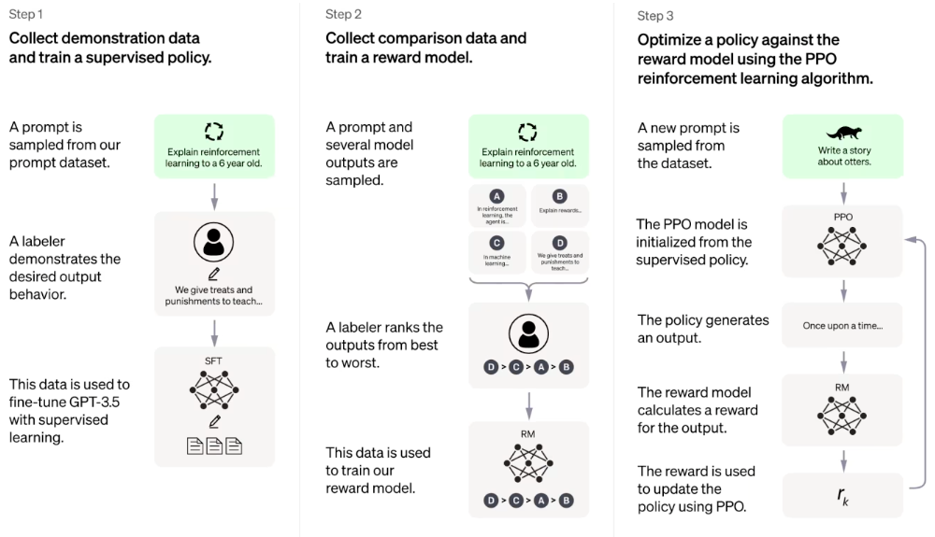
Methodology
ChatGPT works by attempting to understand your prompt and then spitting out strings of words that it predicts will best answer your question, based on the data it was trained on.

Slide 5
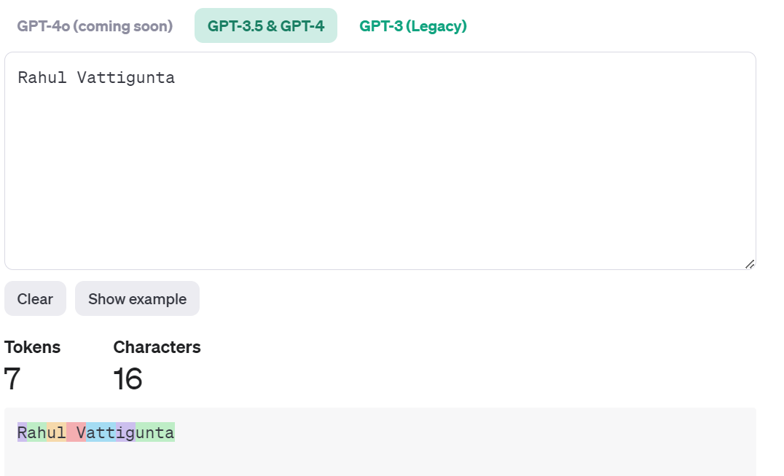
Methodology
Transformer: The transformer model is known for its use of self-attention mechanisms, which allow it to weigh the importance of different words in a sentence, regardless of their position.
Tokenization: OpenAI's large language models process text using tokens, which are common sequences of characters found in a set of text. The models learn to understand the statistical relationships between these tokens, and excel at producing the next token in a sequence of tokens.

Slide 6
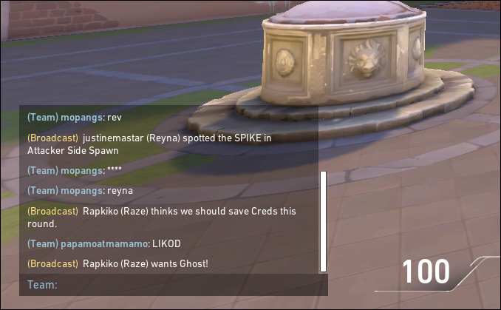
Case Study
For gaming platform:
To deploy a chat interface detection system that uses ChatGPT technology to identify and mitigate harmful interactions in real-time, thereby enhancing the gaming environment and safeguarding the community
Step 1: Data Collection and Preparation: The team collected thousands
of chat logs from the platform, which were manually tagged by
moderators to distinguish between harmful and harmless interactions.
Fig of the Chat in gaming

Slide 7
Case Study
Step 2: Model Training: A transformer-based NLP model was trained on this dataset, focusing on identifying patterns of harassment, threats, and phishing attempts. The model was optimized for high recall to ensure that most harmful interactions were caught.
Step 3: Integration and Testing: The model was integrated into the gaming platform's chat system. Initial tests were conducted in a controlled environment to fine-tune the model's sensitivity and reduce false positives.
Step 4: Real-Time Deployment: The system was rolled out across all game lobbies. It analyzed conversations in real-time, flagging suspicious chats and alerting human moderators.
Step 5: Moderator Interaction: Moderators reviewed the flagged chats and took appropriate actions, including warnings, temporary bans, or permanent bans based on the severity.

Slide 8
Case Study Results
Reduction in Negative Interactions: Within the first three months, the platform observed a 40% reduction in reported cases of harassment.
Improved User Satisfaction: Player surveys indicated a noticeable improvement in the chat environment, with 85% of respondents feeling safer.
Efficient Moderation: The system reduced the workload on human moderators by 60%, allowing them to focus on complex cases and community engagement.

Slide 9
Case Study 2:
For E-Commerce Chat System:
Step 1: Data Collection and Model Training: The team compiled a comprehensive dataset of customer support interactions, labeling them based on the presence of abusive language, scams, and phishing attempts. A transformer-based NLP model was then trained to detect these harmful patterns.
Step 2: System Integration and Pilot Testing: The detection system was integrated into the existing customer support chat interface. A pilot phase was initiated to test the system's performance and adjust its sensitivity to minimize disruptions in genuine customer interactions.

Slide 10
Case Study 2:
Step 3: Deployment and Monitoring: Following successful pilot testing, the system was deployed across all customer support channels. Real-time monitoring was set up to track the system's performance and identify any areas for improvement.
Step 4: Action Protocols: When harmful content was detected, the system automatically flagged the interaction. Depending on the severity, actions ranged from alerting a supervisor to temporarily suspending the chat until a human could intervene.

Slide 11
Case Study 2: Results
Improved Agent Experience: Reports of abusive language towards support agents decreased by over 50%, leading to higher job satisfaction and reduced agent turnover.
Customer Trust and Safety: Instances of customers reporting phishing or scam attempts dropped by 70%, enhancing the overall trust in the company's support services.
Operational Efficiency: The automation of initial harmful interaction detection allowed agents to focus on resolving genuine customer issues, improving response times and overall efficienc

Slide 12
Implementation (Prompt)
Content Filtering: The model has built-in content filters that detect and prevent responses to sensitive or inappropriate prompts. This includes topics related to violence, hate speech, adult content, and illegal activities.
Prompt Sanitization: Before processing, prompts may be sanitized to remove harmful content or intent. This helps ensure that the model does not inadvertently propagate or amplify undesirable content
Contextual Awareness: The model is trained to recognize contexts where sensitive information or potentially harmful content could be involved. It adjusts its responses accordingly to minimize risks

Slide 13
Implementation
Flask : It is a lightweight web application framework written in Python. It's designed to make it easy to develop simple web applications with minimal setup.
Python Programming Language.
BERT : BERT is designed to pre-train deep bidirectional representations by jointly conditioning on both left and right context in all layers
GERT: GERT might refer to specific adaptations or applications of the transformer model, similar to how BERT has been adapted for various languages and domains.

Slide 14
Implementation
Py-Docx: This is used as a backup if the code finds issue with connecting to the keys. The document contains of all the words that’s been banned from usage across most of the platforms.
Load_toxic_phrase: This function is crucial for initializing the application with the criteria to detect toxicity.
HTML Form: The web interface includes two main input fields—one for specifying the path of the API KEY and word document to load new toxic phrases and another for entering text to check its toxicity. The design uses Bootstrap for a clean, modern look and responsiveness.

Slide 15
Implementation
Main Route (/ Endpoint) Purpose: To facilitate both the uploading of new toxic phrases and the checking of text toxicity based on user actions. This dual functionality is central to the application's interactive nature.

Slide 16
Time Complexity
The time complexity of processing a request is dominated by 𝑂(𝑛×𝑚) due to the toxic phrase check.

Slide 17
Future Work
Multilingual Support:
Expand the system to include support for multiple languages using pre-trained multilingual models.
Enhance accessibility and usability for a global user base.
Dynamic Phrase Management:
Implement a dynamic user interface for real-time updating of the phrase list without manual reloads.
Develop algorithms for automated learning from user interactions to adapt and update harmful phrases.
Scalability and Performance:
Optimize for handling larger datasets and maintaining performance through techniques like caching and efficient search algorithms.
Consider distributed processing or microservices architecture for high-load environments.

Slide 18
Conclusion
Robust Error Handling and Case Sensitivity Management: The system effectively handles file path validation and case sensitivity issues, ensuring accuracy and user-friendliness even with varied inputs.
Enhanced User Experience: Through Bootstrap's responsive design and clear feedback mechanisms, the application provides a smooth and intuitive interface for users.
Future Expansion Potential: With possibilities for integrating advanced NLP for better context understanding, supporting multiple languages, and scaling up through API development, the system is well-positioned for broader application and further enhancements.

